Slide 1


Étude de Marché
AUTOMATIC DETECTION OF FAKE BANKNOTES

Slide 2

Context
The National Organization for the Fight against Counterfeiting – A government organisation
The organisation has noticed differences in the dimensions of real and fake banknotes.
Project objective - create an algorithm capable of automatically differentiating real and fake banknotes using the dimensions of the banknotes.

Slide 3
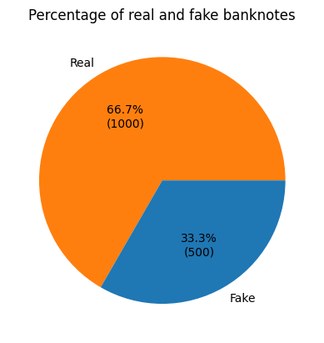
The Data
1500 banknotes
1000 real, 500 fake
7 columns
is_genuine: if the banknote is real or fake
length
height_left
height_right
margin_up: the margin between the top edge of the banknote and the image on the banknote
margin_low: the margin between the bottom edge of the banknote and the image on the banknote
diagonal: measurement of banknote when measured diagonally

Slide 4
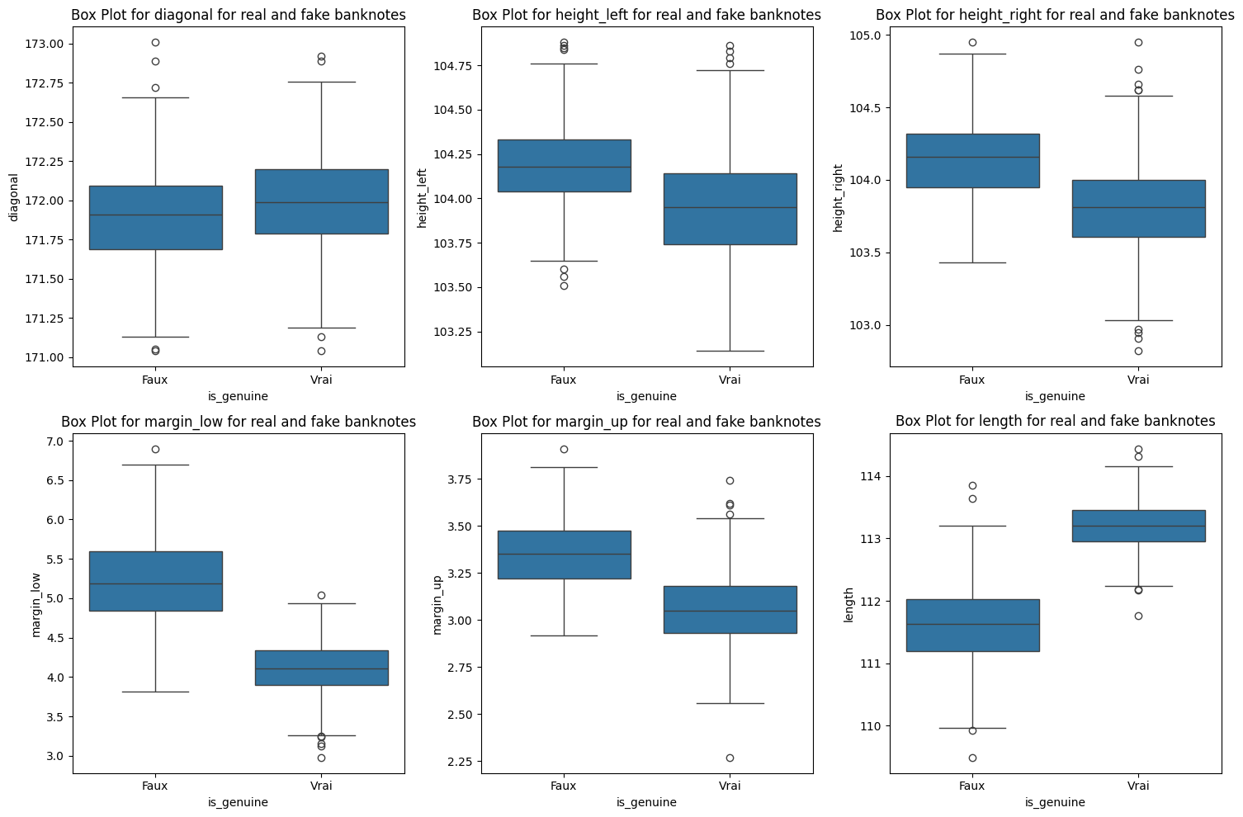
Descriptive Analysis
There are quite big differences between real and fake banknotes in terms of the “length”, “margin_up” and “margin_low” dimensions.
However, the “diagonal”, “height_left”, and “height_right” dimensions are quite similar.

Slide 5
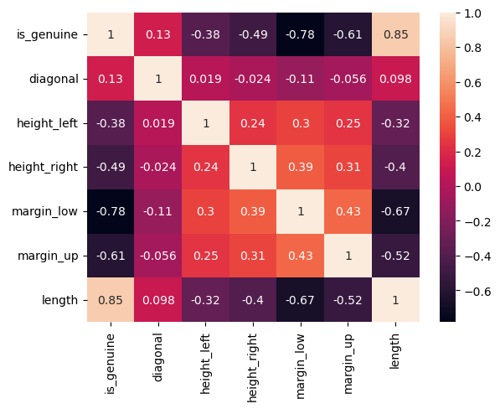
Descriptive Analysis
Most relevant variables for “is_genuine”:
length
margin_low
margin_up
Least important variable for “is_genuine”:
diagonal

Slide 6
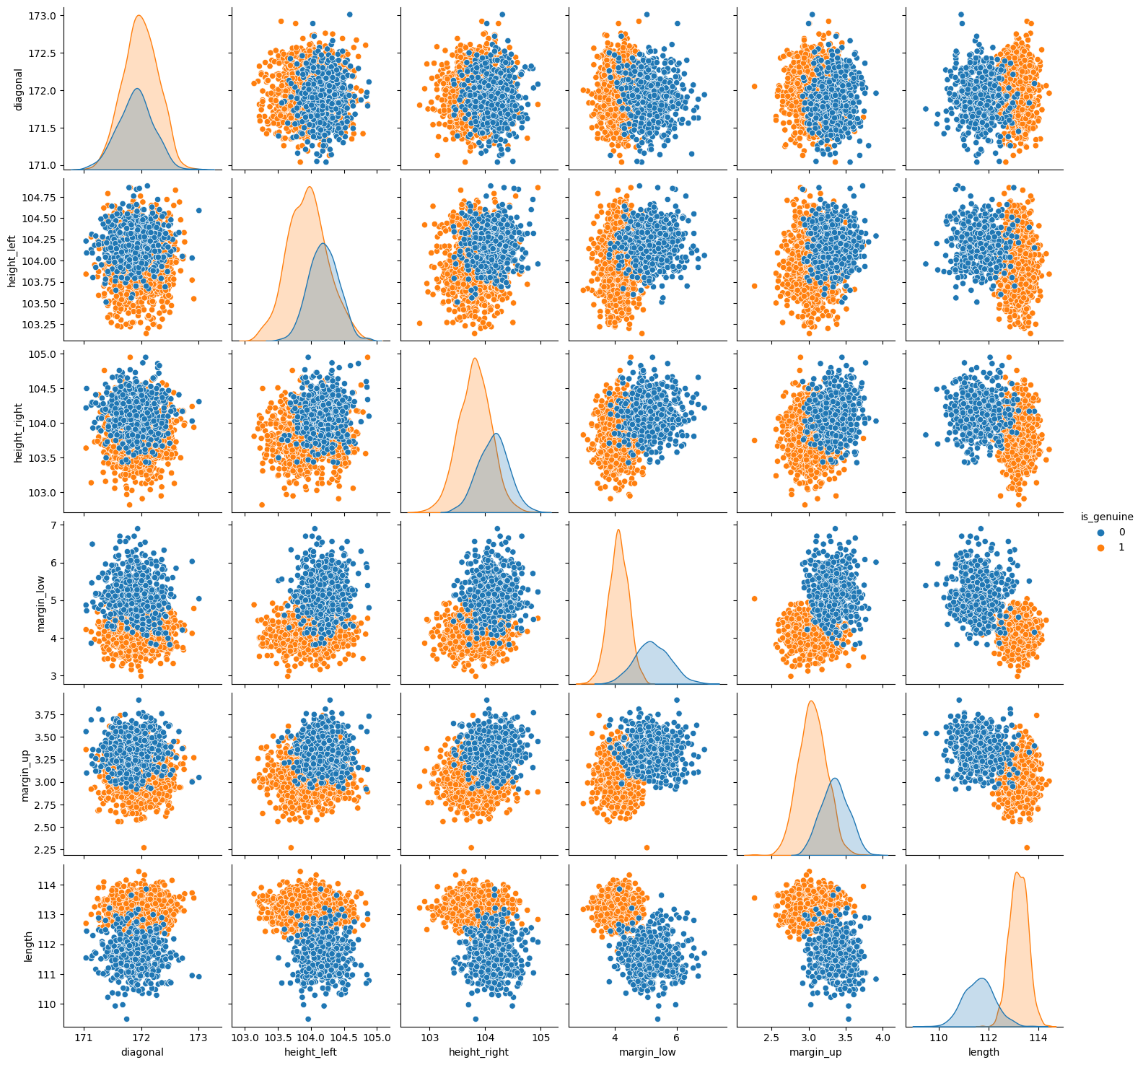
Descriptive Analysis
Kernel density plots
The real and the fake banknotes are clearly differentiated by the “length” and “margin_low” variables.
This is not true for "diagonal", "height_left", and "height_right".
Scatterplots
Scatterplots that contain “length,” “margin_low,” and “margin_up” have fairly well-separated clusters.
Useful for determining which banknotes are real and which are fake.

Slide 7
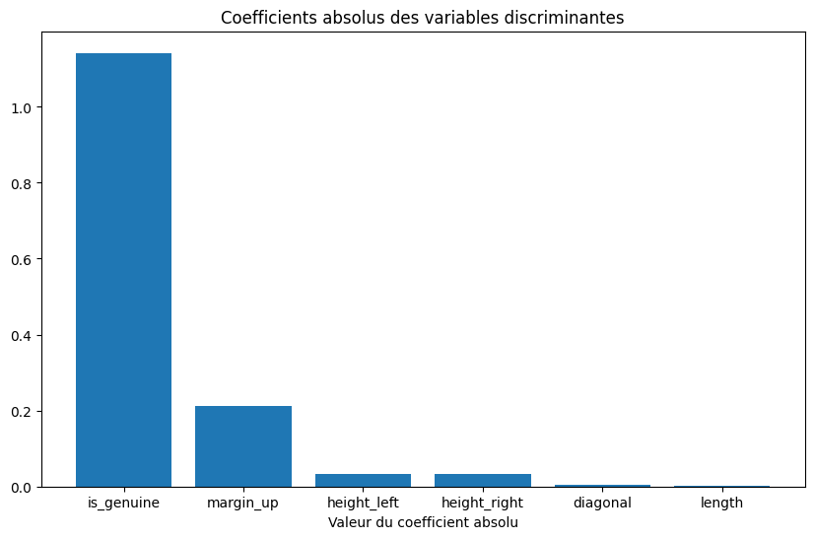
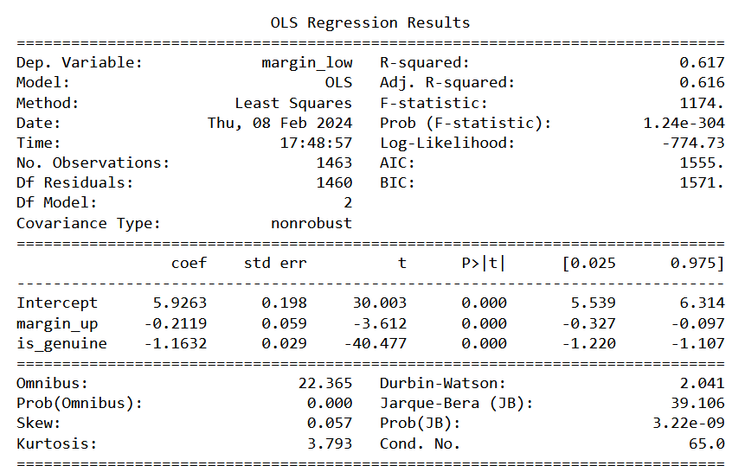
Linear Regression
Bar plot
“is_genuine” has a lot of influence on the “margin_low” variable.
“margin_up” also has a slight influence.
Model
The best model uses only “margin_up and “is_genuine”
R2 = 0.617
Statistically significant (1.24e-403<0.05)
Coefficients – “margin_up” = -0.2119, is_genuine = -1.1632

Slide 8
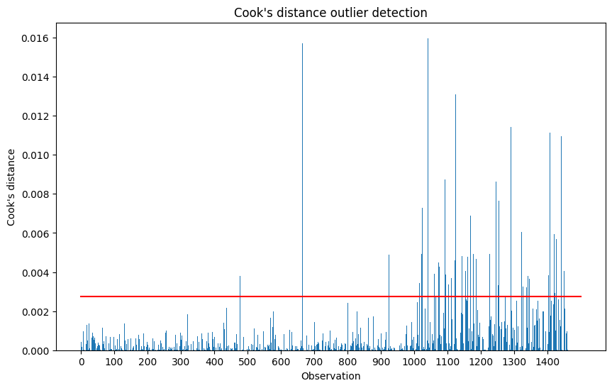
Linear Regression
Cook’s Distance Outliers
79 fake and 14 real banknotes classified as outliers
Process
Outliers for fake banknotes are not very surprising
But the relative differences between the outliers of real banknotes and other real banknotes are more surprising.
After looking at the differences, I removed the 14 real banknotes that were outliers.
93 outliers

Slide 9
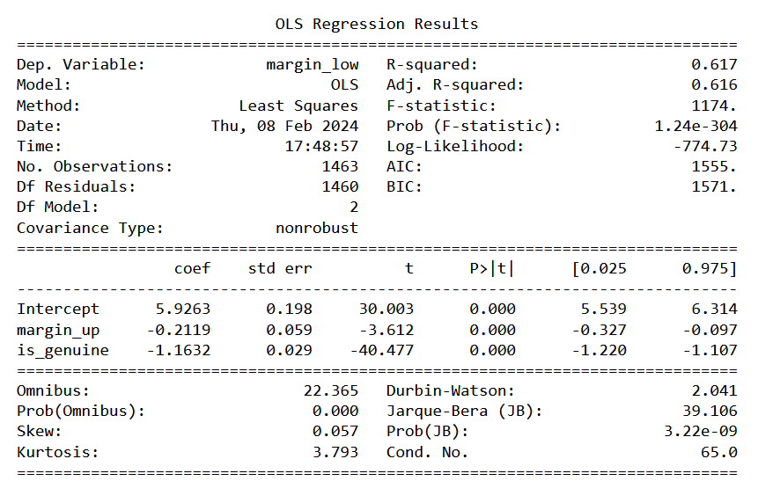
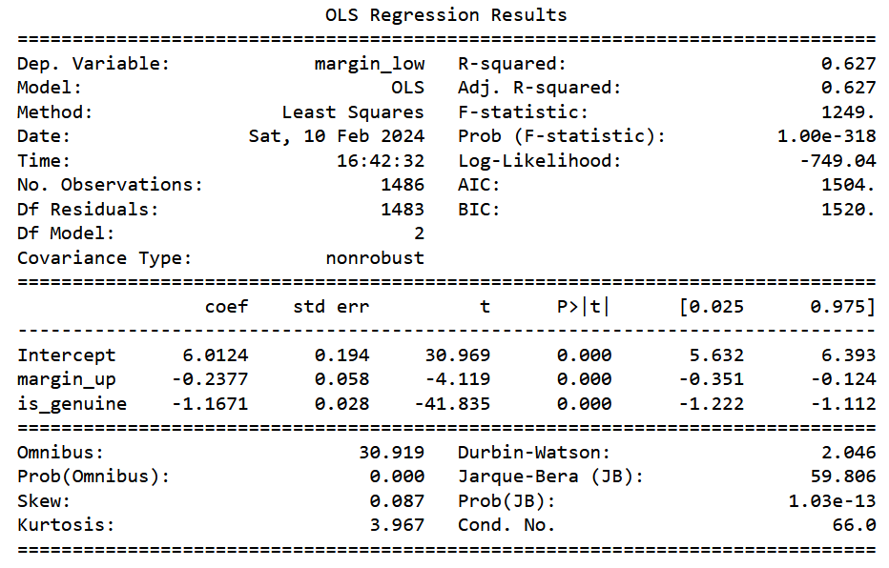
Linear Regression
Before
After

Slide 10
Linear Regression
Distribution of residuals
The statistic of the model is good.
But the p value < 0.05 calls into question the normality of the residuals.
The residuals are not very different from a symmetric distribution and the sample has more than 30 individuals
So, the results obtained by the model are not absurd
Conclusion
I will use this model to impute the missing values (project requirements explicitly required me to).
No problem with colinearity = Valid
VIF for the coefficients = [1.6202, 1.6202]
(Less than 10)
Homoscedasticity = Not valid
Breusch Pagan p-value: 1.9624e-39
Distribution of residuals = Not valid
Statistic = 0.9928
p-value = 1.7644e-06

Slide 11
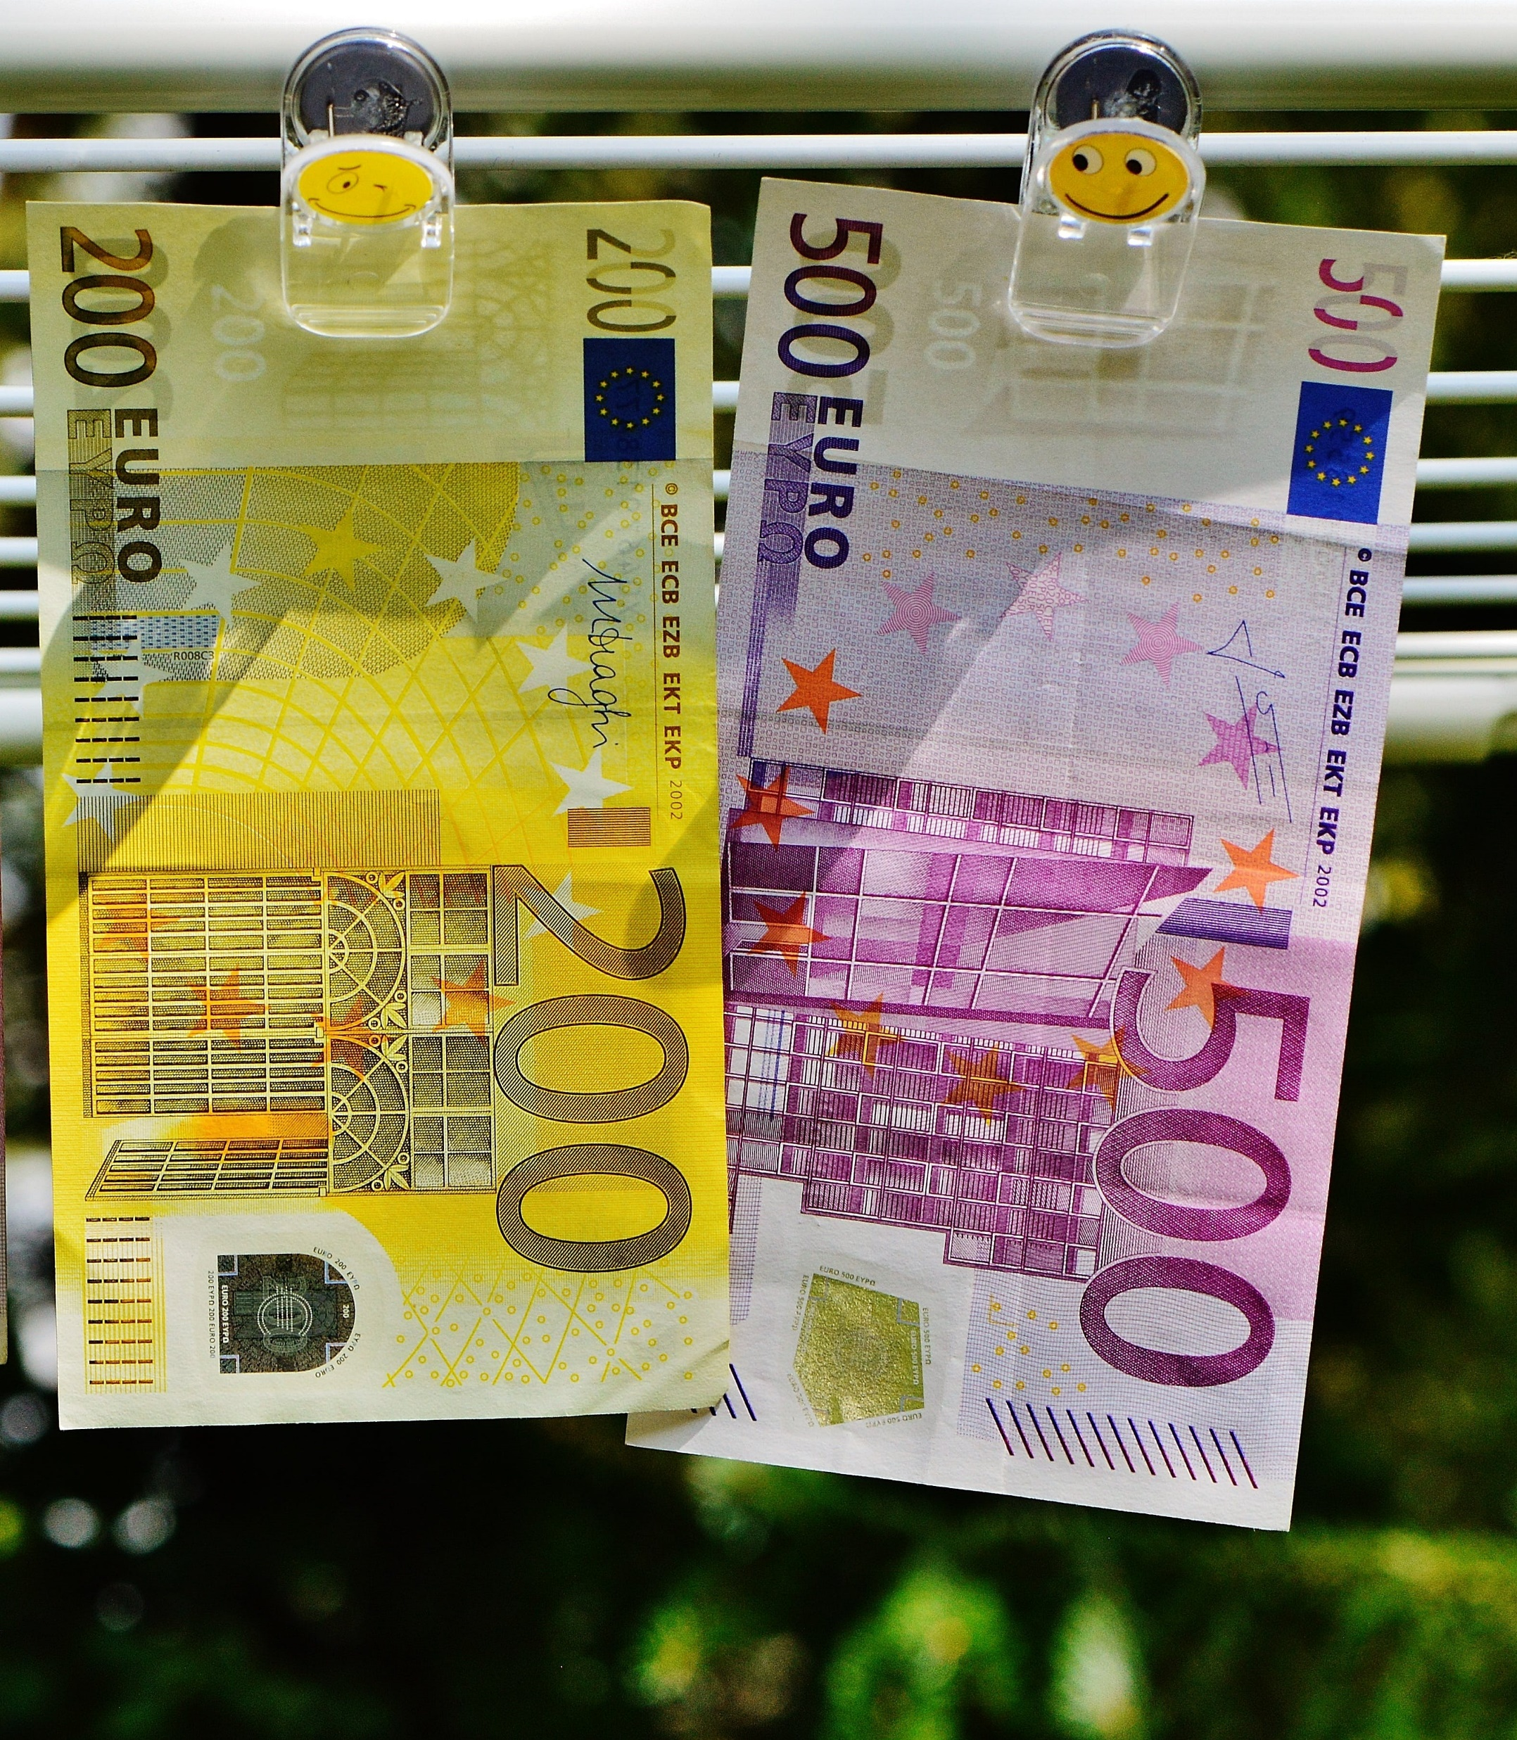
CREATION OF THE ALGORITHMS

Slide 12
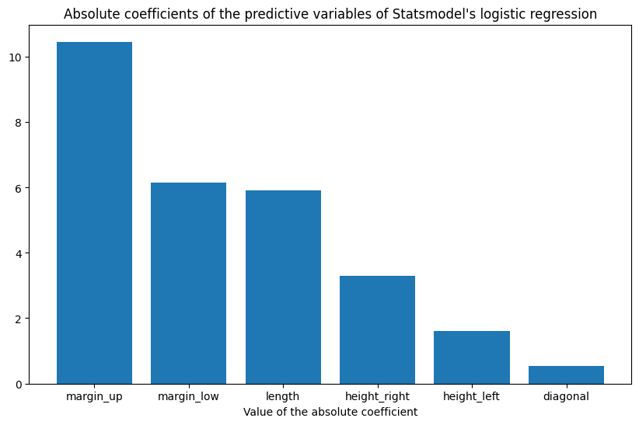
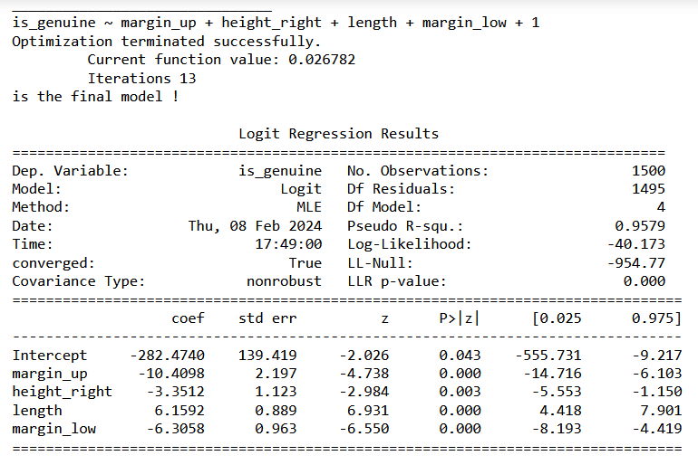
Statsmodels:
Logistic Regression
Bar plot
“margin_up”, “margin_low”, and “length” have a relatively strong influence on “is_genuine”.
Model
The best model uses “margin_up”, “margin_low”, “length” and “height_right”.
Pseudo R2 = 0.9579
Statistically significant (0.00<0.05)
Coefficients – “margin_up” = -10.41, “height_right” = -3.35, “length” = 6.16, “margin_low” = -6.31

Slide 13
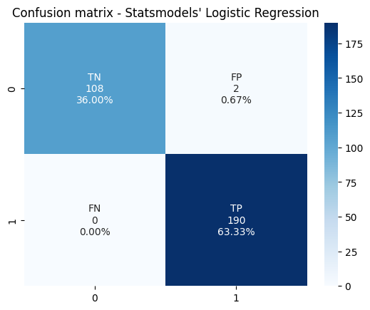
Statsmodels – Logistic Regression
Accuracy: 99.33%
Precision: 98.96%
Recall: 100%
ROC-AUC: 0.9909

Slide 14
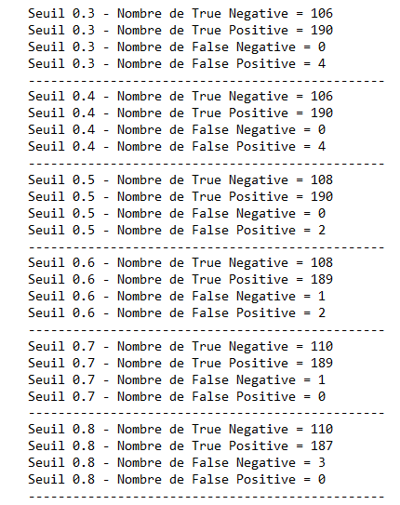
Statsmodels:
Logistic Regression
Increase the threshold = Reduce the number of false positives
Reduce the threshold = Reduce the number of false negatives
Threshold of 0.7
No false positives
BUT 1 false negative

Slide 15

Statsmodels – Logistic Regression
Accuracy: 99.67%
Precision: 100%
Recall: 99.47%
ROC-AUC: 0.9974

Slide 16
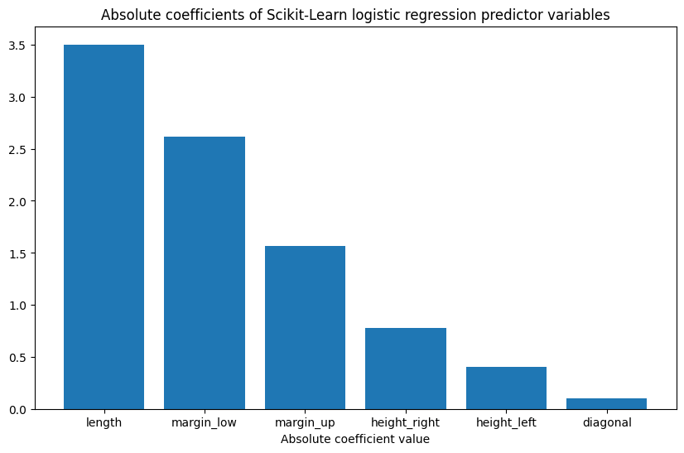
SciKit-Learn:
Logistic Regression
Bar plot
“length”, “margin_low” and “margin_up” have the strongest influence on “is_genuine”.
Model
The best model uses "length", "margin_low", and "margin_up", and "height_right".
Using fewer variables simplifies the model and reduces the risk of overfitting.
 | Accuracy | Precision | Recall | ROC-AUC score
Length, margin_low, margin_up, height_right, height_left, diagonal | 0.9933 | 0.9896 | 1 | 0.9909
Length, margin_low, margin_up, height_right, height_left | 0.9933 | 0.9896 | 1 | 0.9909
Length, margin_low, margin_up, height_right | 0.99 | 0.9845 | 1 | 0.9864
Length, margin_low, margin_up | 0.9933 | 0.9896 | 1 | 0.9909
Length, margin_low | 0.9867 | 0.9794 | 1 | 0.9818
Length | 0.9533 | 0.94 | 1 | 0.9402

Slide 17

SciKit-Learn – Logistic Regression
Accuracy: 99%
Precision: 98,45%
Recall: 100%
ROC-AUC: 0,9864

Slide 18
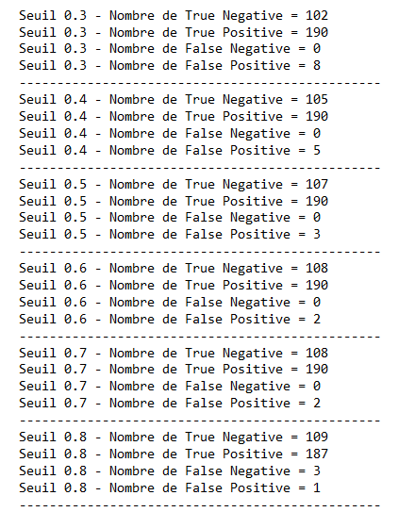
Scikit-Learn:
Logistic Regression
Increase the threshold = Reduce the number of false positives
Reduce the threshold = Reduce the number of false négatives
Threshold of 0.6 or 0.7
No false negatives
2 false positives

Slide 19

SciKit-Learn – Logistic Regression
Accuracy: 99,33%
Precision: 98,96%
Recall: 100%
ROC-AUC: 0,9909

Slide 20
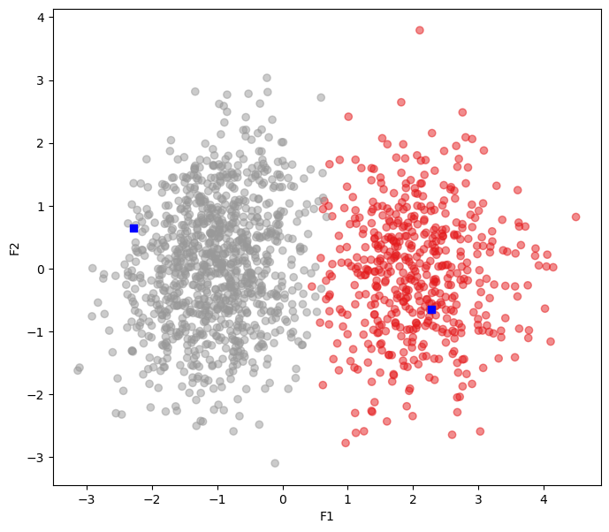
K-means
Number of clusters
No need for the elbow method – 2 clusters – the real and the fake banknotes
K-means plot
2 well-defined clusters

Slide 21
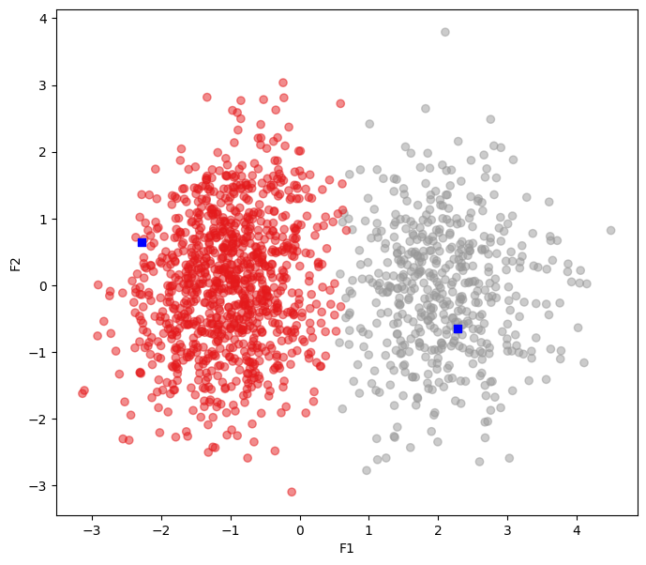
K-means
Accuracy: 98,67%
Precision: 99,49%
Recall: 98,48%
ROC-AUC: 0,9875

Slide 22
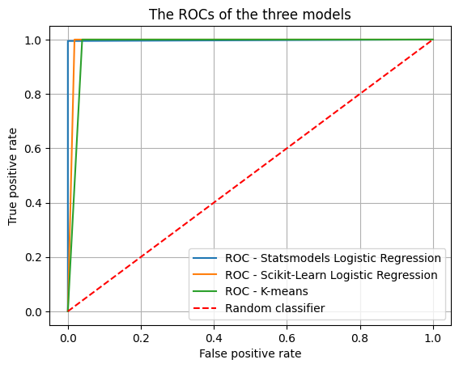
Conclusion
Best algorithm:
Statsmodels logistic regression
Best accuracy score
Best precision score
Best ROC-AUC score
 | Accuracy | Precision | Recall | ROC-AUC score
Statsmodels Logistic Regression | 0.9967 | 1 | 0.9947 | 0.9974
Scikit-Learn Logistic Regression | 0.9933 | 0.9896 | 1 | 0.9909
K-means | 0.9867 | 0.9802 | 1 | 0.9804

